Slide 1

CS589-04 Digital Image Processing
Lecture 6. Image Segmentation
Spring 2008
New Mexico Tech

Slide 2
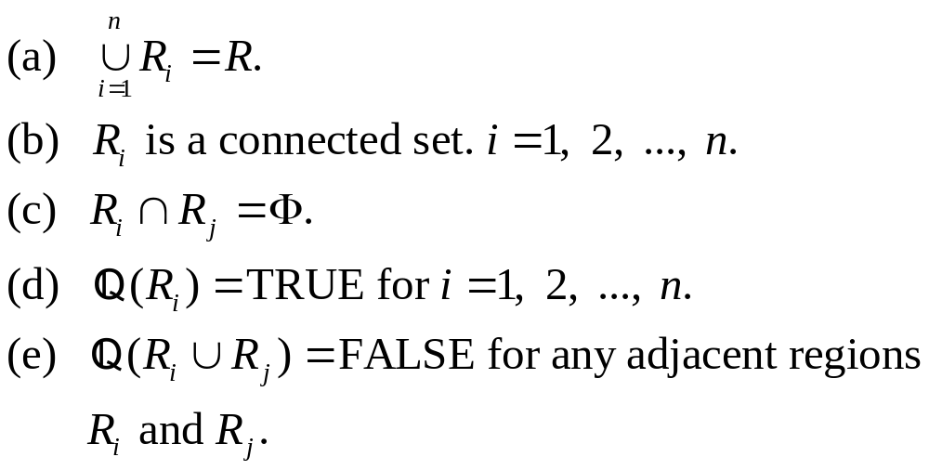
Fundamentals
Let R represent the entire spatial region occupied by an image. Image segmentation is a process that partitions R into n sub-regions, R₁, R₂, …, R_{n}, such that

Slide 3


Slide 4
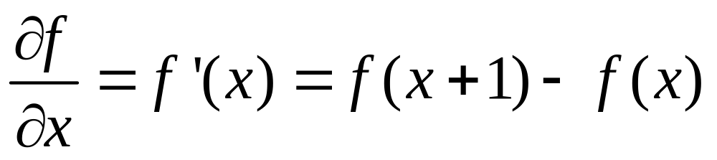
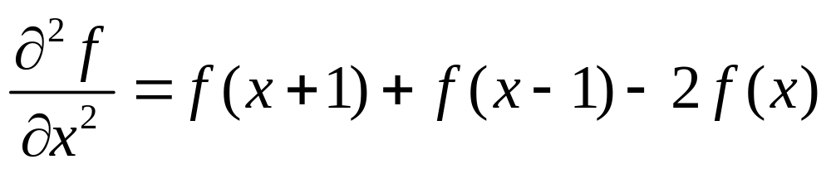
Background
First-order derivative
Second-order derivative

Slide 6
Characteristics of First and Second Order Derivatives
First-order derivatives generally produce thicker edges in image
Second-order derivatives have a stronger response to fine detail, such as thin lines, isolated points, and noise
Second-order derivatives produce a double-edge response at ramp and step transition in intensity
The sign of the second derivative can be used to determine whether a transition into an edge is from light to dark or dark to light

Slide 7
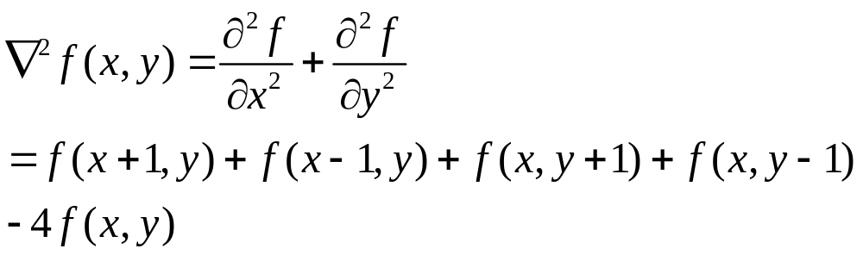
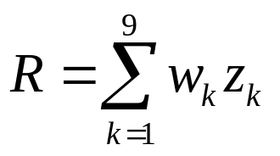
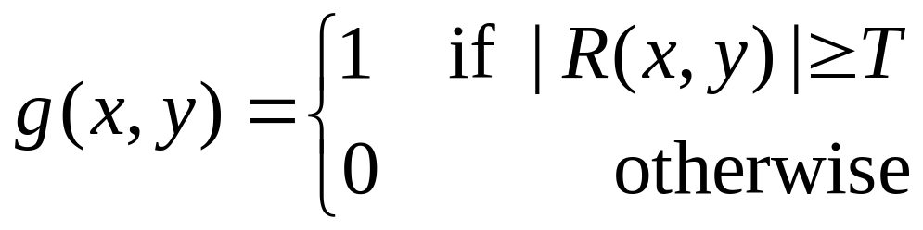
Detection of Isolated Points
The Laplacian

Slide 8
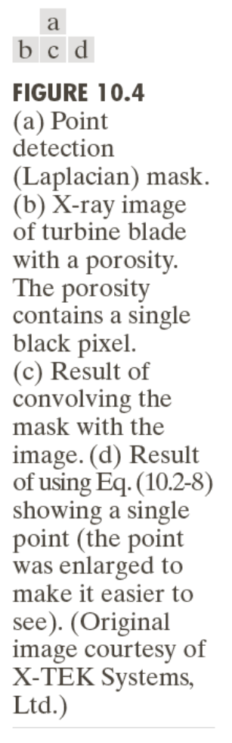

Slide 9
Line Detection
Second derivatives to result in a stronger response and to produce thinner lines than first derivatives
Double-line effect of the second derivative must be handled properly

Slide 10
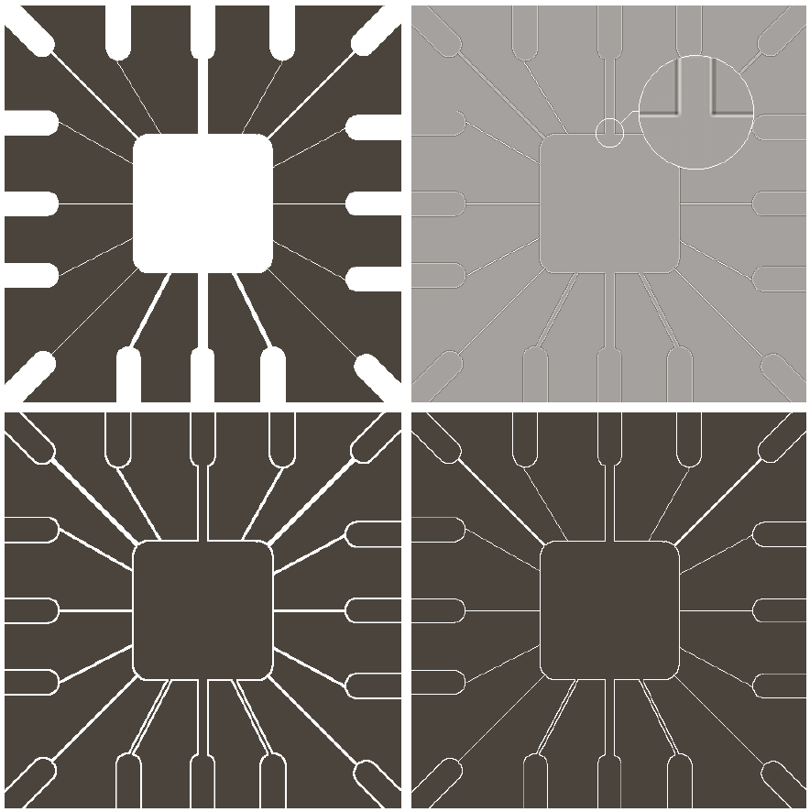

Slide 11
Detecting Line in Specified Directions
Let R₁, R₂, R₃, and R₄ denote the responses of the masks in Fig. 10.6. If, at a given point in the image, |R_{k}|>|R_{j}|, for all j≠k, that point is said to be more likely associated with a line in the direction of mask k.

Slide 12


Slide 13

Edge Detection
Edges are pixels where the brightness function changes abruptly
Edge models

Slide 14
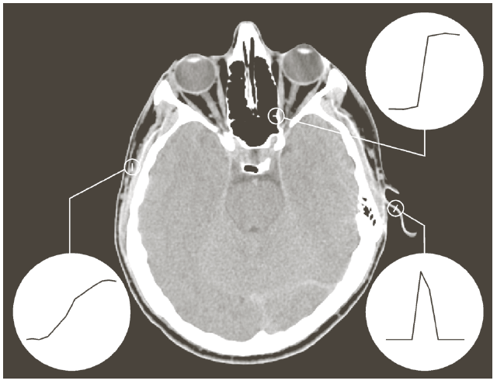
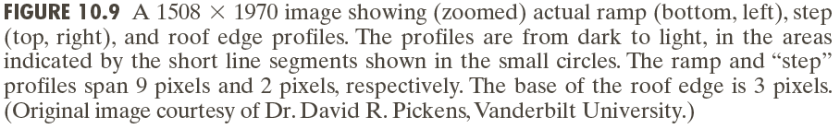

Slide 16
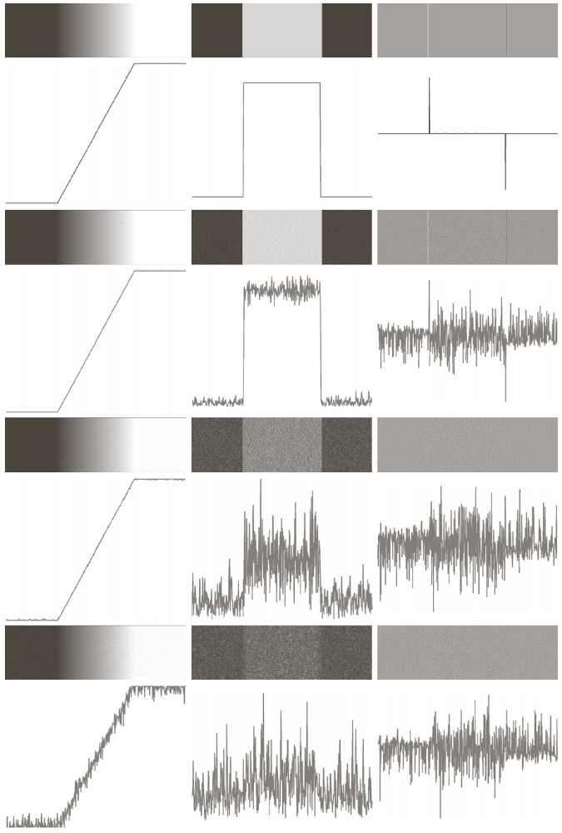
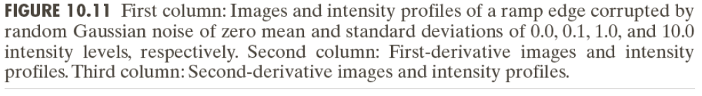

Slide 17
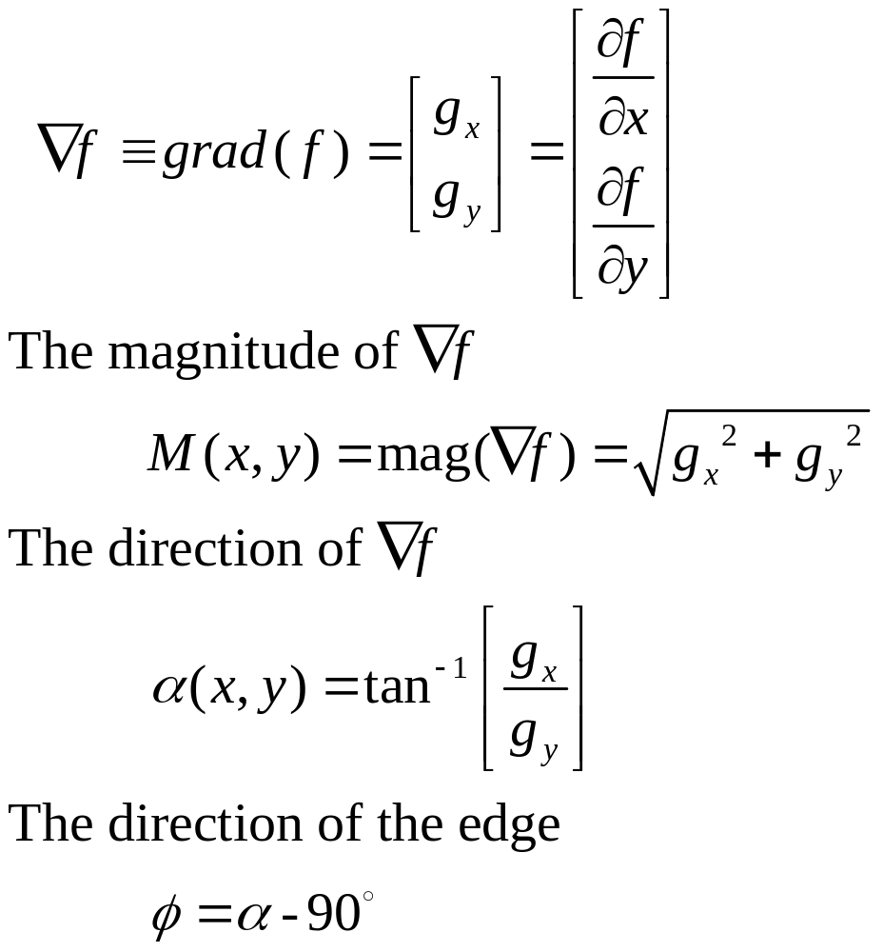
Basic Edge Detection by Using First-Order Derivative

Slide 18
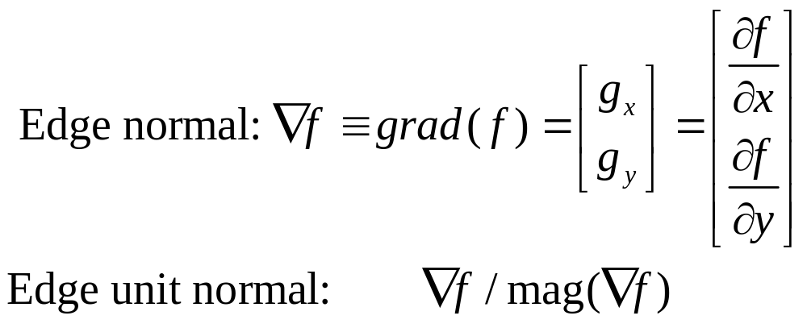
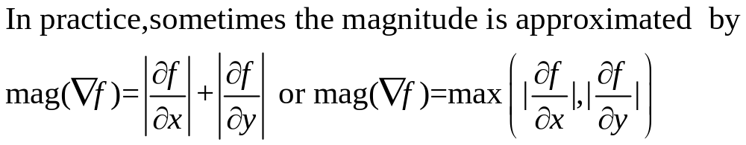
Basic Edge Detection by Using First-Order Derivative

Slide 19
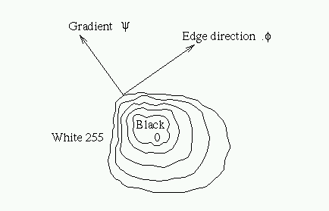

Slide 23
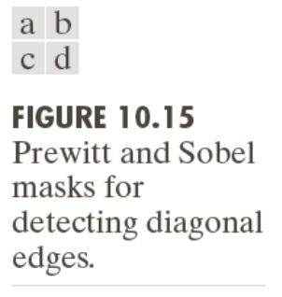

Slide 24
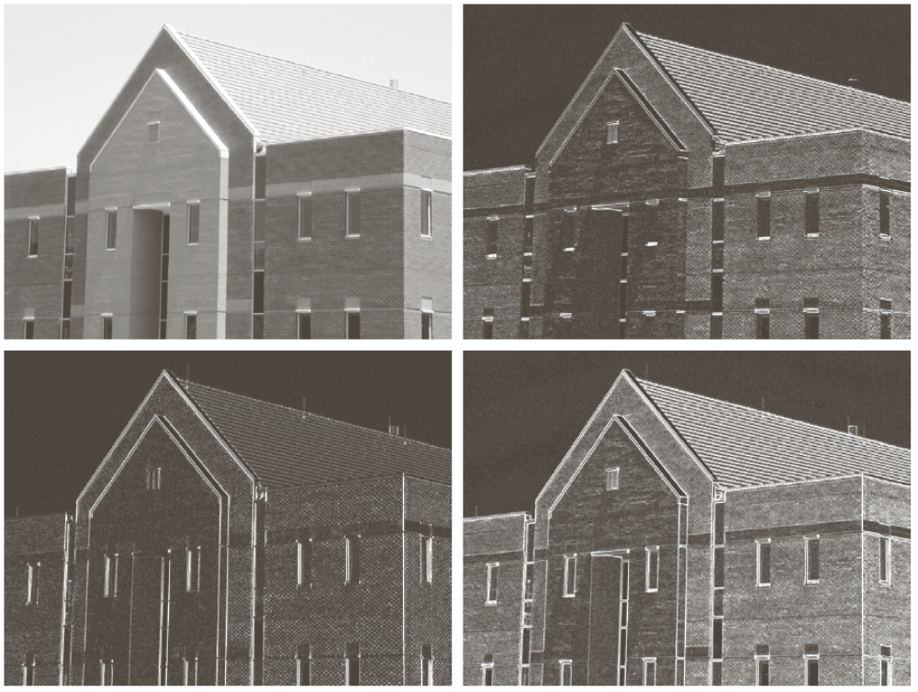
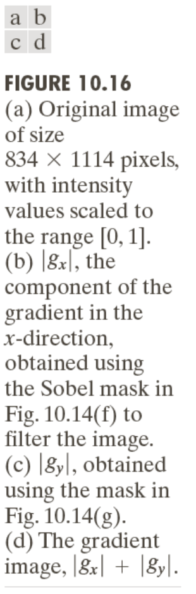

Slide 25
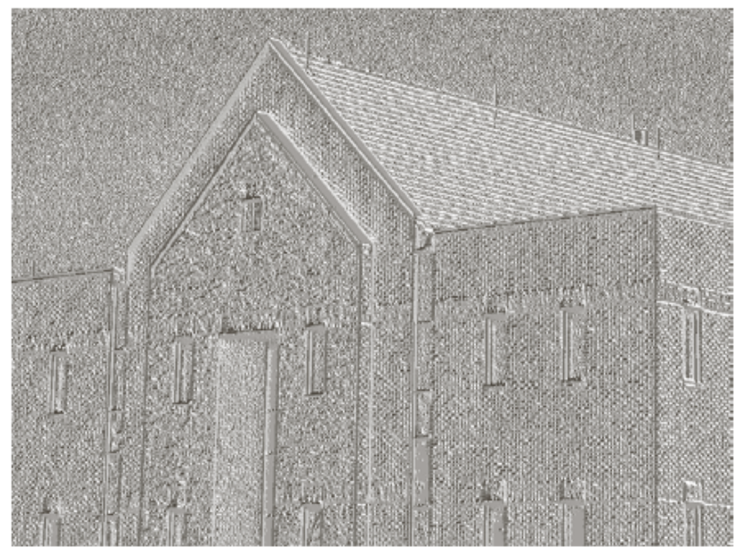

Slide 26
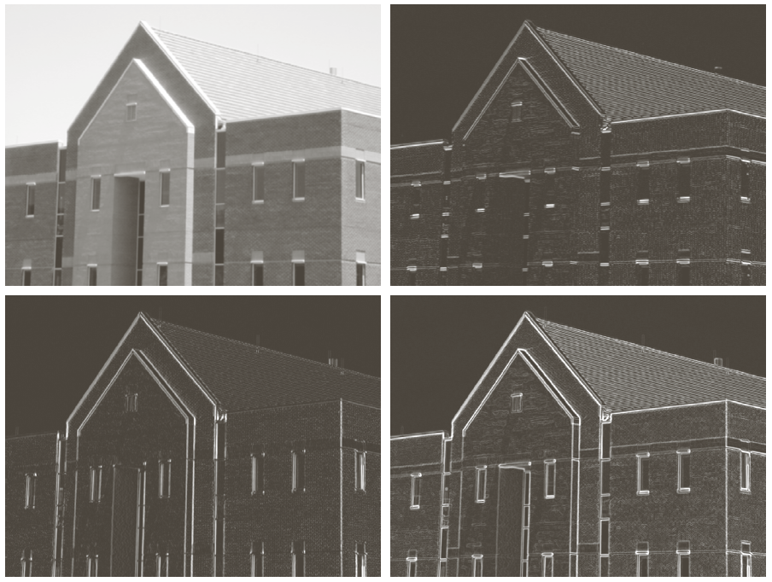

Slide 28
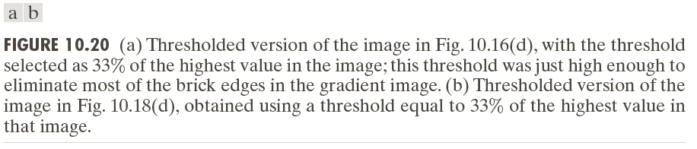

Slide 29
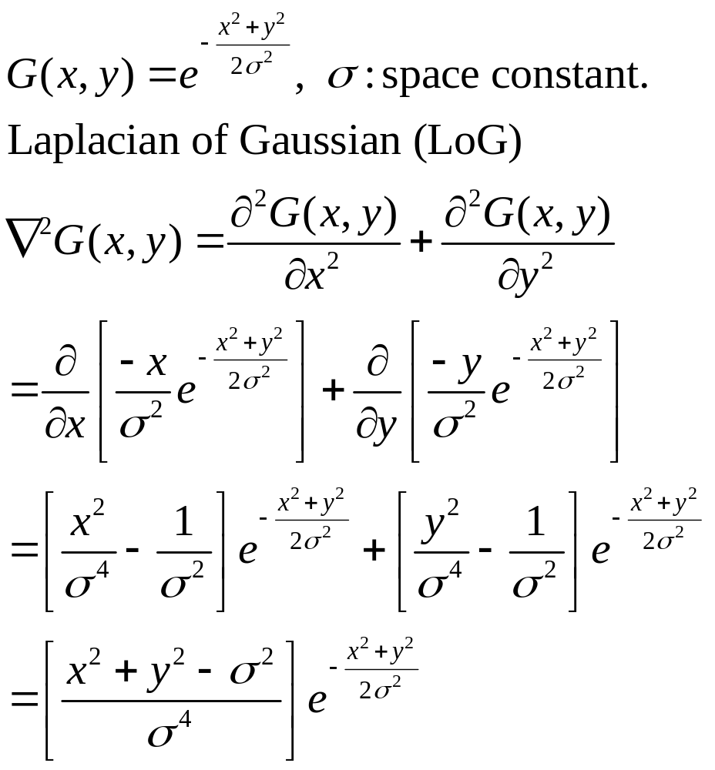
Advanced Techniques for Edge Detection
The Marr-Hildreth edge detector

Slide 30
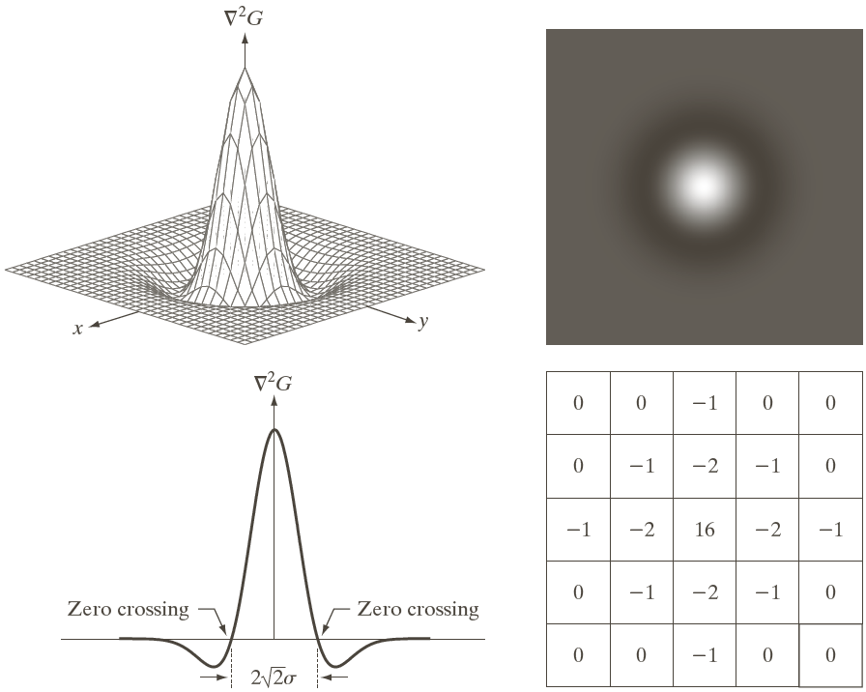
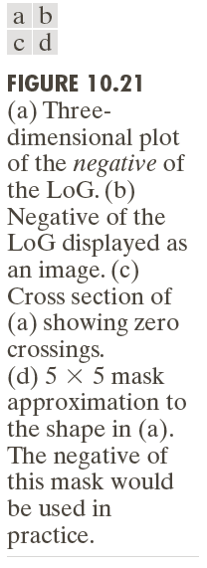

Slide 31

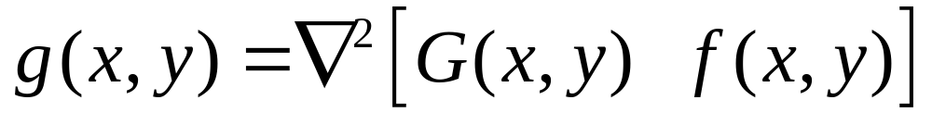
Marr-Hildreth Algorithm
Filter the input image with an nxn Gaussian lowpass filter. N is the smallest odd integer greater than or equal to 6
Compute the Laplacian of the image resulting from step1
Find the zero crossing of the image from step 2

Slide 32
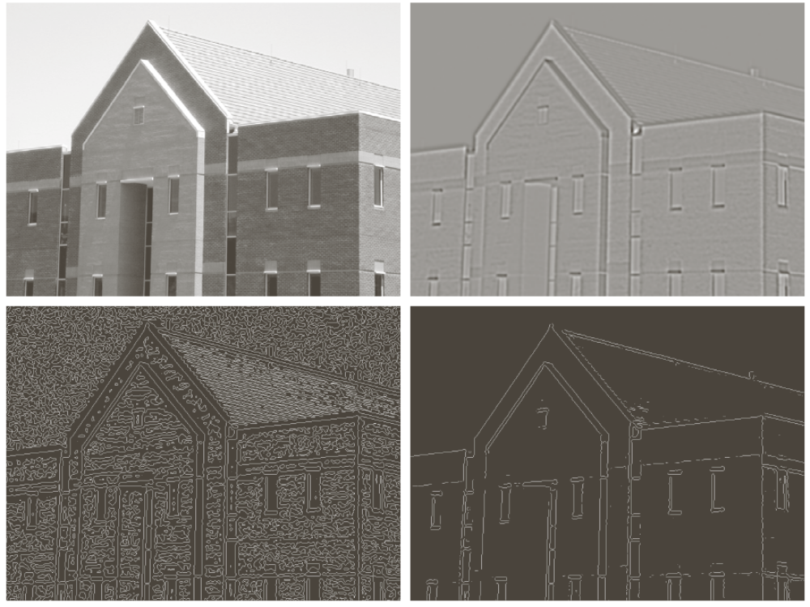
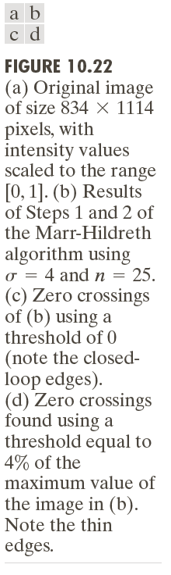

Slide 33
The Canny Edge Detector
Optimal for step edges corrupted by white noise.
The Objective
Low error rate
The edges detected must be as close as possible to the true edge
Edge points should be well localized
The edges located must be as close as possible to the true edges
Single edge point response
The number of local maxima around the true edge should be minimum

Slide 34
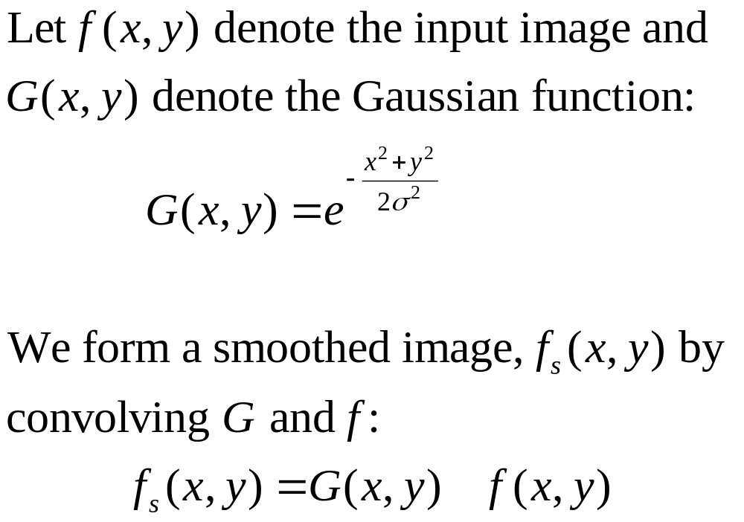
The Canny Edge Detector: Algorithm (1)

Slide 35
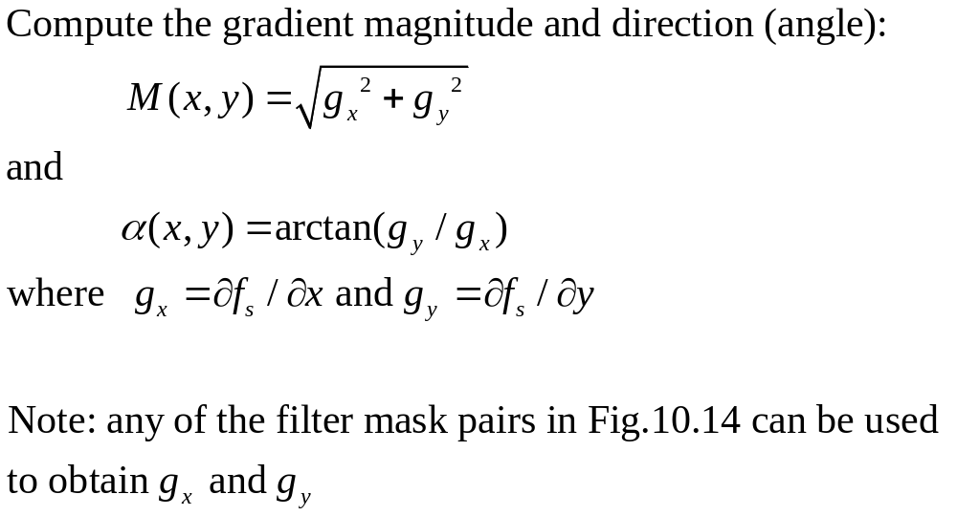
The Canny Edge Detector: Algorithm(2)

Slide 36
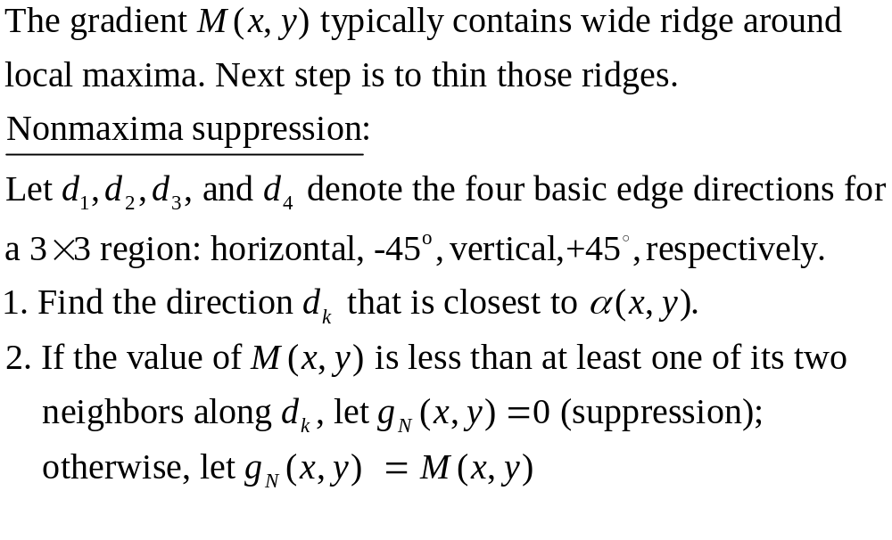
The Canny Edge Detector: Algorithm(3)

Slide 37
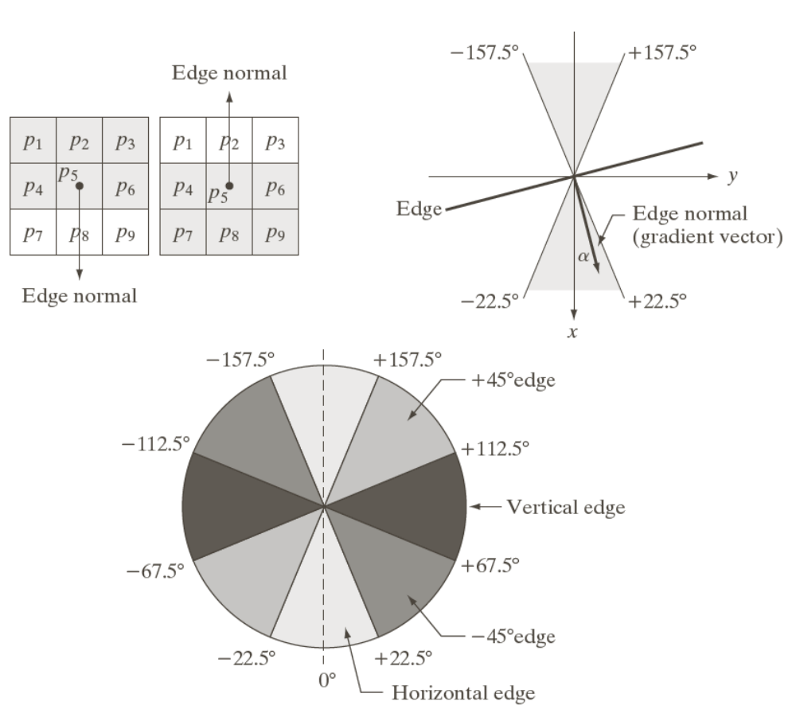
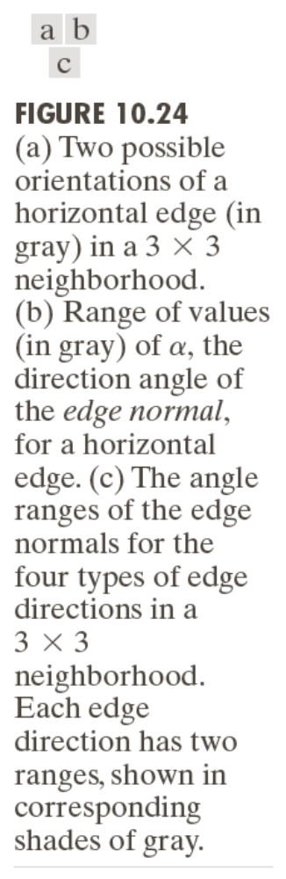

Slide 38
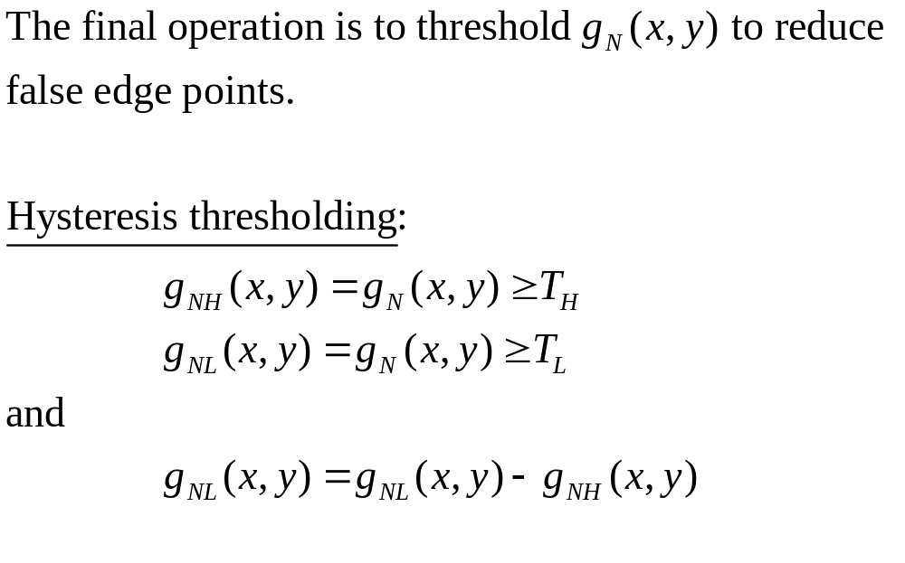
The Canny Edge Detector: Algorithm(4)

Slide 39
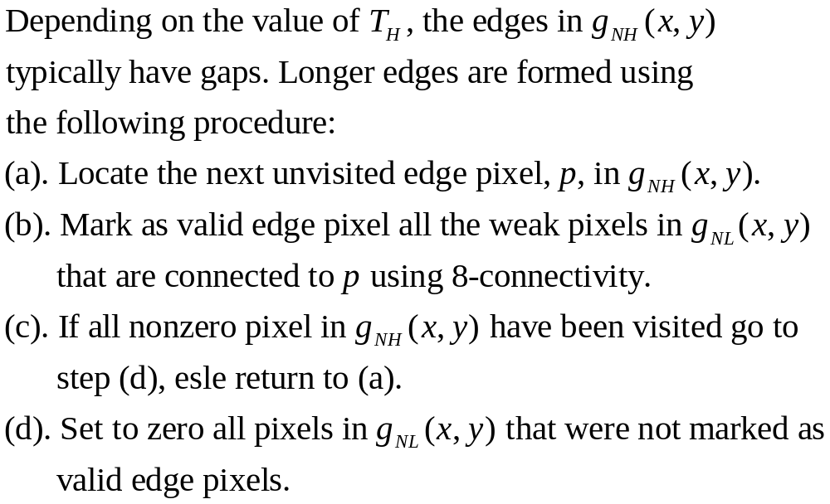
The Canny Edge Detector: Algorithm(5)

Slide 40
The Canny Edge Detection: Summary
Smooth the input image with a Gaussian filter
Compute the gradient magnitude and angle images
Apply nonmaxima suppression to the gradient magnitude image
Use double thresholding and connectivity analysis to detect and link edges

Slide 41
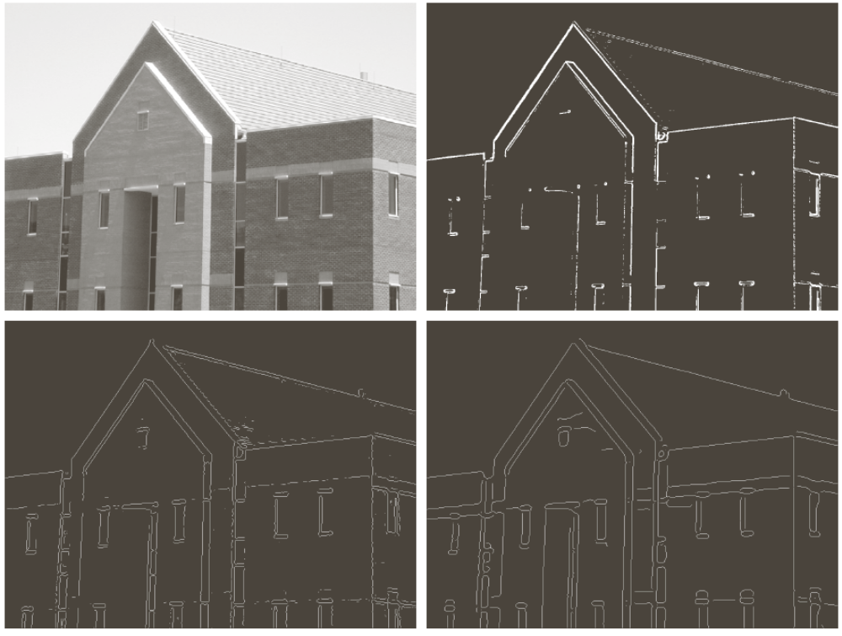
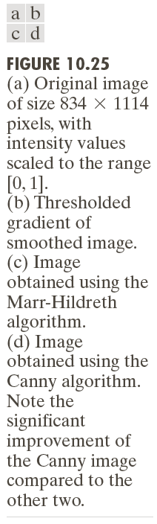

Slide 42
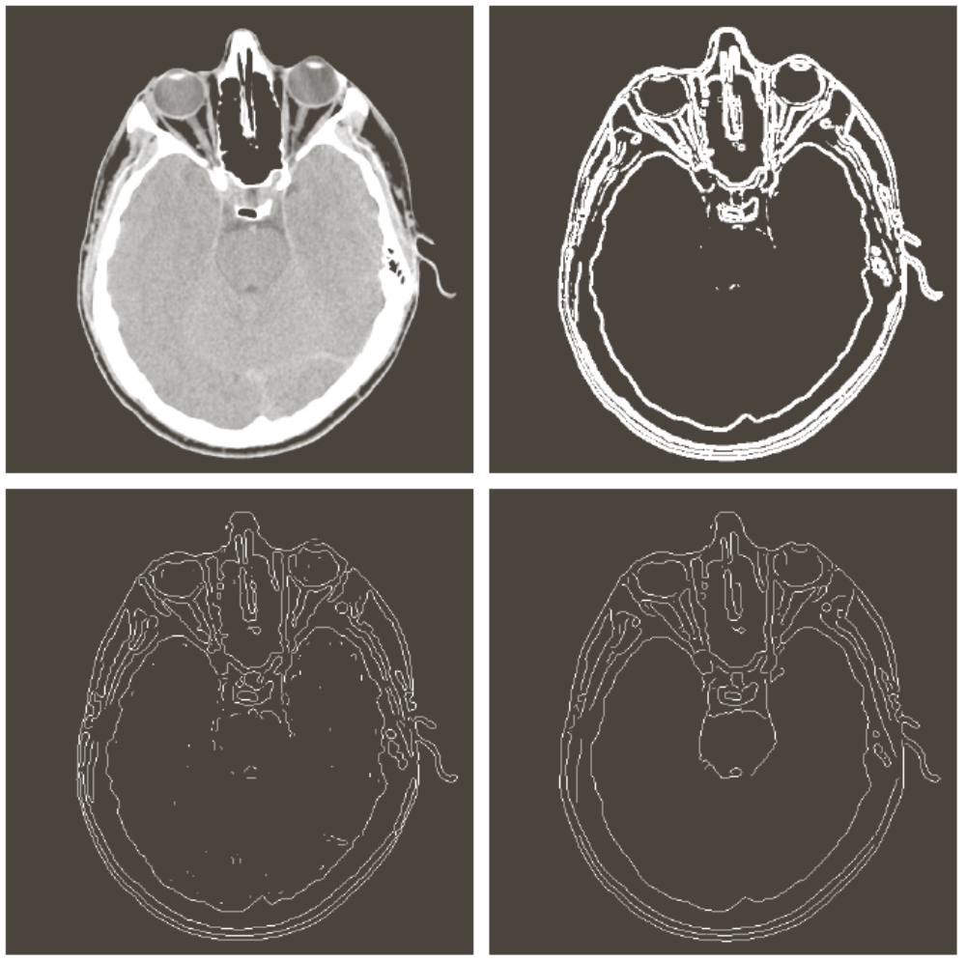
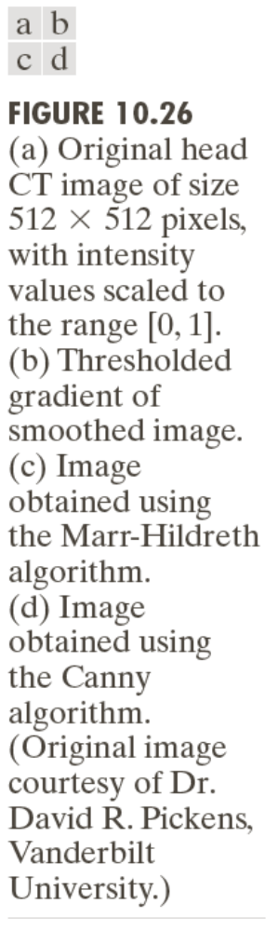

Slide 43


Slide 44


Slide 45
Edge Linking and Boundary Detection
Edge detection typically is followed by linking algorithms designed to assemble edge pixels into meaningful edges and/or region boundaries
Three approaches to edge linking
Local processing
Regional processing
Global processing

Slide 46
Local Processing
Analyze the characteristics of pixels in a small neighborhood about every point (x,y) that has been declared an edge point
All points that similar according to predefined criteria are linked, forming an edge of pixels.
Establishing similarity: (1) the strength (magnitude) and (2) the direction of the gradient vector.
A pixel with coordinates (s,t) in S_{xy} is linked to the pixel at (x,y) if both magnitude and direction criteria are satisfied.

Slide 47
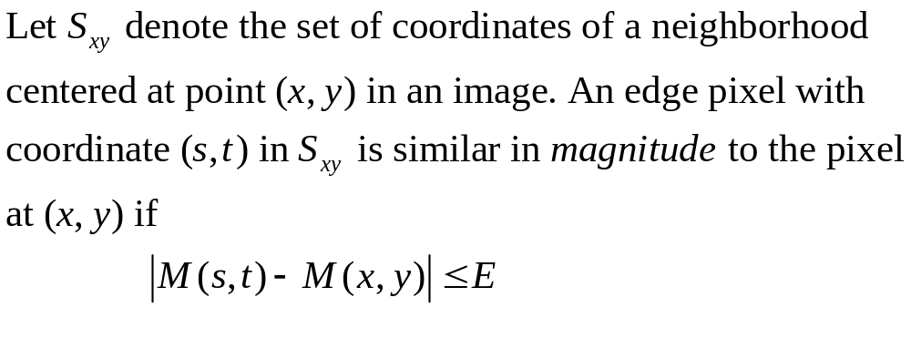
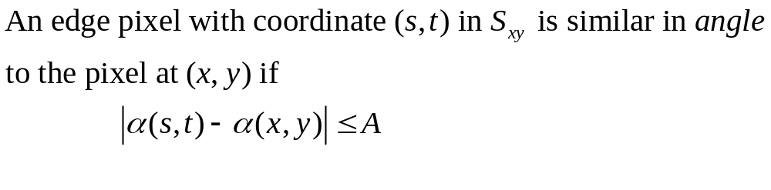
Local Processing

Slide 48

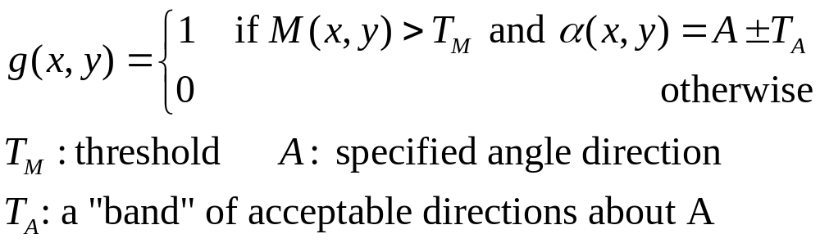
Local Processing: Steps (1)
Compute the gradient magnitude and angle arrays, M(x,y) and , of the input image f(x,y)
Form a binary image, g, whose value at any pair of coordinates (x,y) is given by

Slide 49
Local Processing: Steps (2)
Scan the rows of g and fill (set to 1) all gaps (sets of 0s) in each row that do not exceed a specified length, K.
To detect gaps in any other direction, rotate g by this angle and apply the horizontal scanning procedure in step 3.

Slide 50
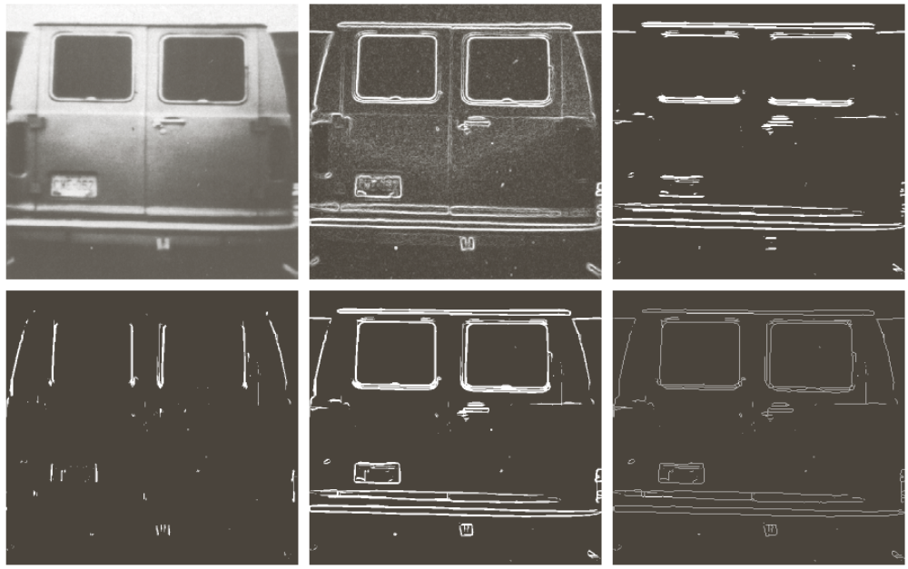
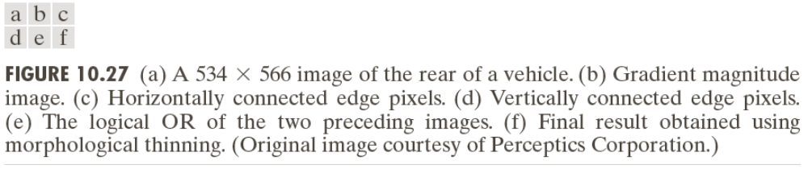

Slide 51
Regional Processing
The location of regions of interest in an image are known or can be determined
Polygonal approximations can capture the essential shape features of a region while keeping the representation of the boundary relatively simple
Open or closed curve
Open curve: a large distance between two consecutive points in the ordered sequence relative to the distance between other points

Slide 52
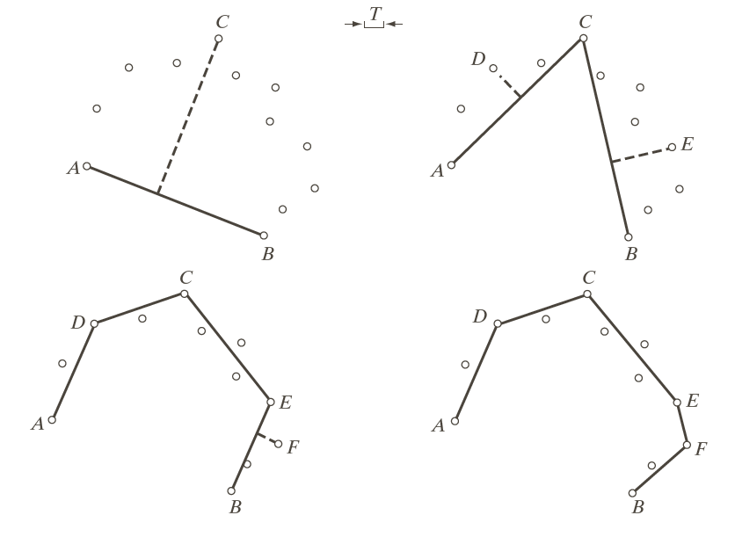
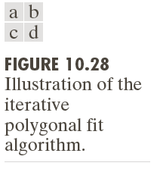

Slide 53
Regional Processing: Steps
Let P be the sequence of ordered, distinct, 1-valued points of a binary image. Specify two starting points, A and B.
Specify a threshold, T, and two empty stacks, OPEN and ClOSED.
If the points in P correspond to a closed curve, put A into OPEN and put B into OPEN and CLOSES. If the points correspond to an open curve, put A into OPEN and B into CLOSED.
Compute the parameters of the line passing from the last vertex in CLOSED to the last vertex in OPEN.

Slide 54
Regional Processing: Steps
Compute the distances from the line in Step 4 to all the points in P whose sequence places them between the vertices from Step 4. Select the point, V_{max}, with the maximum distance, D_{max}
If D_{max}> T, place V_{max} at the end of the OPEN stack as a new vertex. Go to step 4.
Else, remove the last vertex from OPEN and insert it as the last vertex of CLOSED.
If OPEN is not empty, go to step 4.
Else, exit. The vertices in CLOSED are the vertices of the polygonal fit to the points in P.

Slide 55
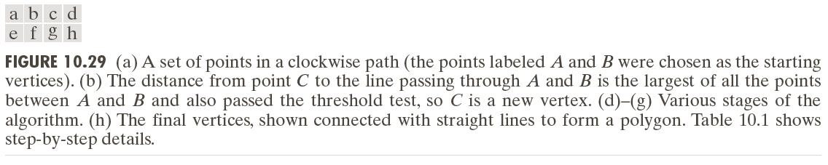

Slide 56
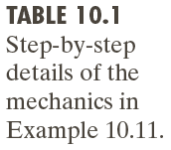

Slide 57
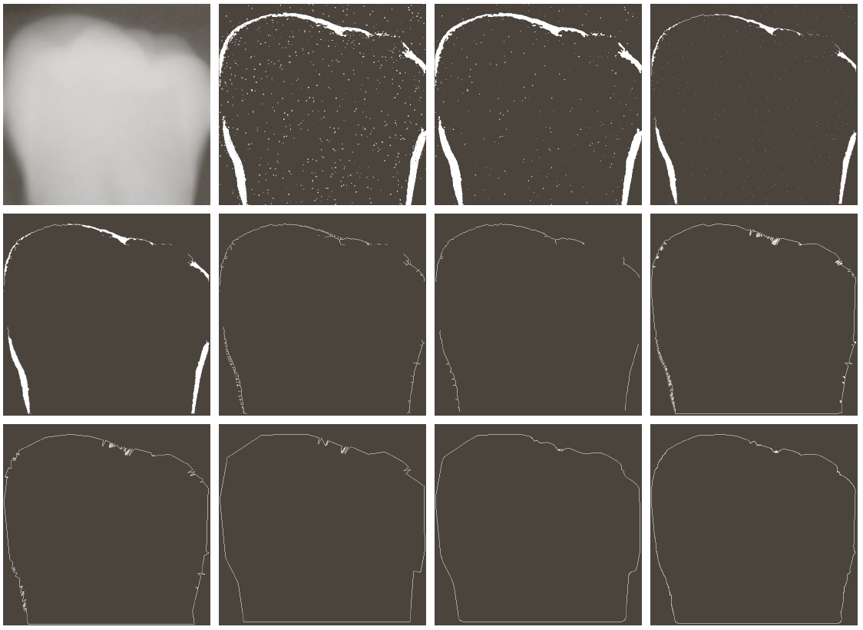

Slide 58
Global Processing Using the Hough Transform
“The Hough transform is a general technique for identifying the locations and orientations of certain types of features in a digital image. Developed by Paul Hough in 1962 and patented by IBM, the transform consists of parameterizing a description of a feature at any given location in the original image’s space. A mesh in the space defined by these parameter is then generated, and at each mesh point a value is accumulated, indicating how well an object generated by the parameters defined at that point fits the given image. Mesh points that accumulate relatively larger values then describe features that may be projected back onto the image, fitting to some degree the features actually present in the image.”
http://planetmath.org/encyclopedia/HoughTransform.html

Slide 59
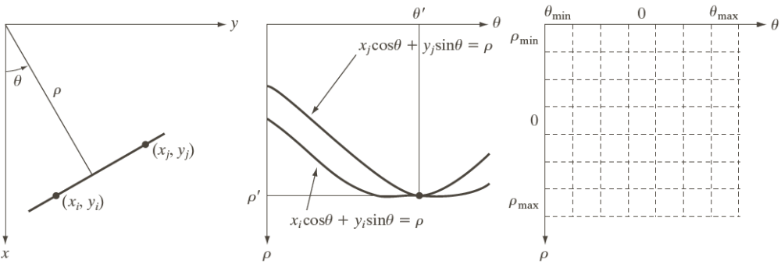


Slide 61

Edge-linking Based on the Hough Transform
Obtain a binary edge image
Specify subdivisions in
Examine the counts of the accumulator cells for high pixel concentrations
Examine the relationship between pixels in chosen cell

Slide 62


Slide 63


Slide 64


Thresholding

Slide 65



Slide 66

The Role of Noise in Image Thresholding

Slide 67


The Role of Illumination and Reflectance

Slide 68



Basic Global Thresholding
Select an initial estimate for the global threshold, T.
Segment the image using T. It will produce two groups of pixels: G1 consisting of all pixels with intensity values > T and G2 consisting of pixels with values T.
Compute the average intensity values m1 and m2 for the pixels in G1 and G2, respectively.
Compute a new threshold value.
Repeat Steps 2 through 4 until the difference between values of T in successive iterations is smaller than a predefined parameter .

Slide 69


Slide 70


Optimum Global Thresholding Using Otsu’s Method
Principle: maximizing the between-class variance

Slide 71


Optimum Global Thresholding Using Otsu’s Method

Slide 72

Optimum Global Thresholding Using Otsu’s Method

Slide 73



Optimum Global Thresholding Using Otsu’s Method

Slide 74
Otsu’s Algorithm: Summary
Compute the normalized histogram of the input image. Denote the components of the histogram by p_{i}, i=0, 1, …, L-1.
Compute the cumulative sums, P₁(k), for k = 0, 1, …, L-1.
Compute the cumulative means, m(k), for k = 0, 1, …, L-1.
Compute the global intensity mean, m_{G}.
Compute the between-class variance, for k = 0, 1, …, L-1.

Slide 75
Otsu’s Algorithm: Summary
Obtain the Otsu’s threshold, k*.
Obtain the separability measure.

Slide 76



Slide 77


Using Image Smoothing to Improve Global Thresholding

Slide 78


Using Edges to Improve Global Thresholding

Slide 79
Using Edges to Improve Global Thresholding
Compute an edge image as either the magnitude of the gradient, or absolute value of the Laplacian of f(x,y)
Specify a threshold value T
Threshold the image and produce a binary image, which is used as a mask image; and select pixels from f(x,y) corresponding to “strong” edge pixels
Compute a histogram using only the chosen pixels in f(x,y)
Use the histogram from step 4 to segment f(x,y) globally

Slide 80



Slide 81


Slide 82


Multiple Thresholds

Slide 83



Slide 84
Variable Thresholding: Image Partitioning
Subdivide an image into nonoverlapping rectangles
The rectangles are chosen small enough so that the illumination of each is approximately uniform.

Slide 85



Slide 86



Slide 87


Variable Thresholding Based on Local Image Properties

Slide 88


Variable Thresholding Based on Local Image Properties

Slide 89
a=30
b=1.5
m_{xy} = m_{G}

Slide 90
Variable Thresholding Using Moving Averages
Thresholding based on moving averages works well when the objects are small with respect to the image size
Quite useful in document processing
The scanning (moving) typically is carried out line by line in zigzag pattern to reduce illumination bias

Slide 91

Variable Thresholding Using Moving Averages

Slide 92

Variable Thresholding Using Moving Averages

Slide 93


N = 20
b=0.5

Slide 94



Slide 95
Region-Based Segmentation
Region Growing
Region growing is a procedure that groups pixels or subregions into larger regions.
The simplest of these approaches is pixel aggregation, which starts with a set of “seed” points and from these grows regions by appending to each seed points those neighboring pixels that have similar properties (such as gray level, texture, color, shape).
Region growing based techniques are better than the edge-based techniques in noisy images where edges are difficult to detect.

Slide 96

Region-Based Segmentation
Example: Region Growing based on 8-connectivity

Slide 97

Region Growing based on 8-connectivity

Slide 98


Slide 99


Slide 100
4-connectivity

Slide 101
8-connectivity

Slide 102


Slide 103


Slide 104

Region Splitting and Merging

Slide 107


Slide 108


Segmentation Using Morphological Watersheds
Three types of points in a topographic interpretation:
  Points belonging to a regional minimum
  Points at which a drop of water would fall to a single minimum. (→The catchment basin or watershed of that minimum.)
  Points at which a drop of water would be equally likely to fall to more than one minimum. (→The divide lines or watershed lines.)
Watershed lines

Slide 109

Segmentation Using Morphological Watersheds: Backgrounds
http://www.icaen.uiowa.edu/~dip/LECTURE/Segmentation3.html#watershed

Slide 110


Watershed Segmentation: Example
The objective is to find watershed lines.
The idea is simple:
  Suppose that a hole is punched in each regional minimum and that the entire topography is flooded from below by letting water rise through the holes at a uniform rate.
  When rising water in distinct catchment basins is about the merge, a dam is built to prevent merging. These dam boundaries correspond to the watershed lines.

Slide 111



Slide 112


Slide 113
Watershed Segmentation Algorithm
Start with all pixels with the lowest possible value.
  These form the basis for initial watersheds
For each intensity level k:
  For each group of pixels of intensity k
    If adjacent to exactly one existing region, add these pixels to that region
    Else if adjacent to more than one existing regions, mark as boundary
    Else start a new region

Slide 114


Watershed Segmentation: Examples
Watershed algorithm is often used on the gradient image instead of the original image.

Slide 115

Watershed Segmentation: Examples
Due to noise and other local irregularities of the gradient, over-segmentation might occur.

Slide 116

Watershed Segmentation: Examples
A solution is to limit the number of regional minima. Use markers to specify the only allowed regional minima.

Slide 117

Watershed Segmentation: Examples
A solution is to limit the number of regional minima. Use markers to specify the only allowed regional minima. (For example, gray-level values might be used as a marker.)

Slide 118
Use of Motion in Segmentation

Slide 119
K-means Clustering
Partition the data points into K clusters randomly. Find the centroids of each cluster.
For each data point:
  Calculate the distance from the data point to each cluster.
  Assign the data point to the closest cluster.
Recompute the centroid of each cluster.
Repeat steps 2 and 3 until there is no further change in the assignment of data points (or in the centroids).

Slide 120
K-Means Clustering

Slide 121
K-Means Clustering

Slide 122
K-Means Clustering

Slide 123
K-Means Clustering

Slide 124
K-Means Clustering

Slide 125
K-Means Clustering

Slide 126
K-Means Clustering

Slide 127
K-Means Clustering

Slide 128




Clustering
Example
D. Comaniciu and P. Meer, Robust Analysis of Feature Spaces:
Color Image Segmentation, 1997.

